Slide 1


Slide 2


Slide 3


AI-Assisted Road Tracing validated by editors to increase road coverage in OpenStreetMap

Slide 4



Continue the conversation online
@sotm | #sotm
tinyurl.com/sotm-telegram

Slide 5
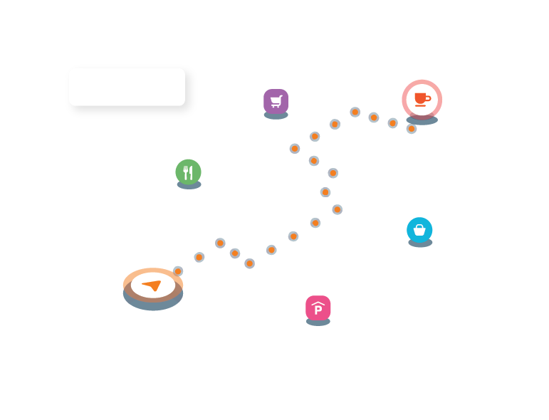

Building experiences
for exploring the world
mapbox.com

Slide 6
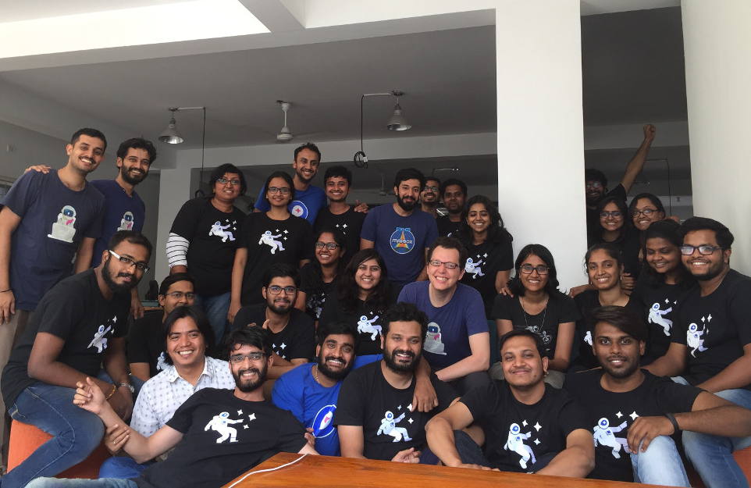
Happy mapping from Mapbox
Mapbox Bangalore

Slide 7


Slide 8

Android app for the program, maps, tweets from @sotm and more!
2018.stateofthemap.org/sotm.apk

Slide 9


Slide 10


Slide 11
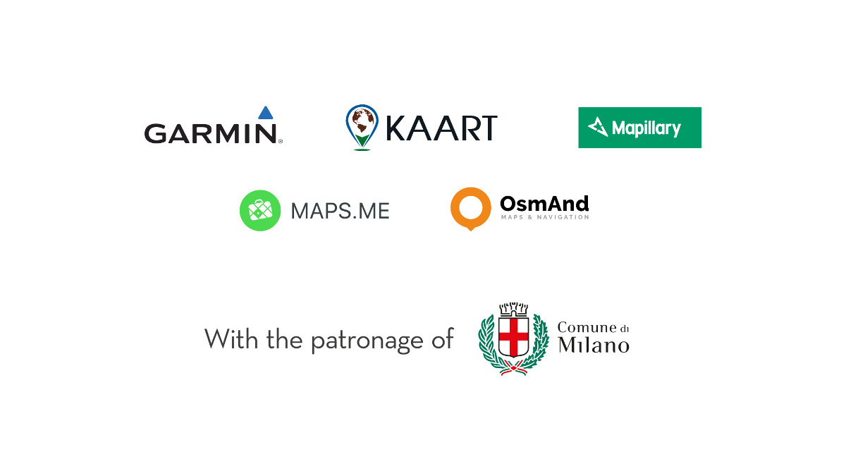

Slide 12


Slide 13

